Slide 1

Modeling Diabetic Patient Mortality
Ian Wittler

Slide 2
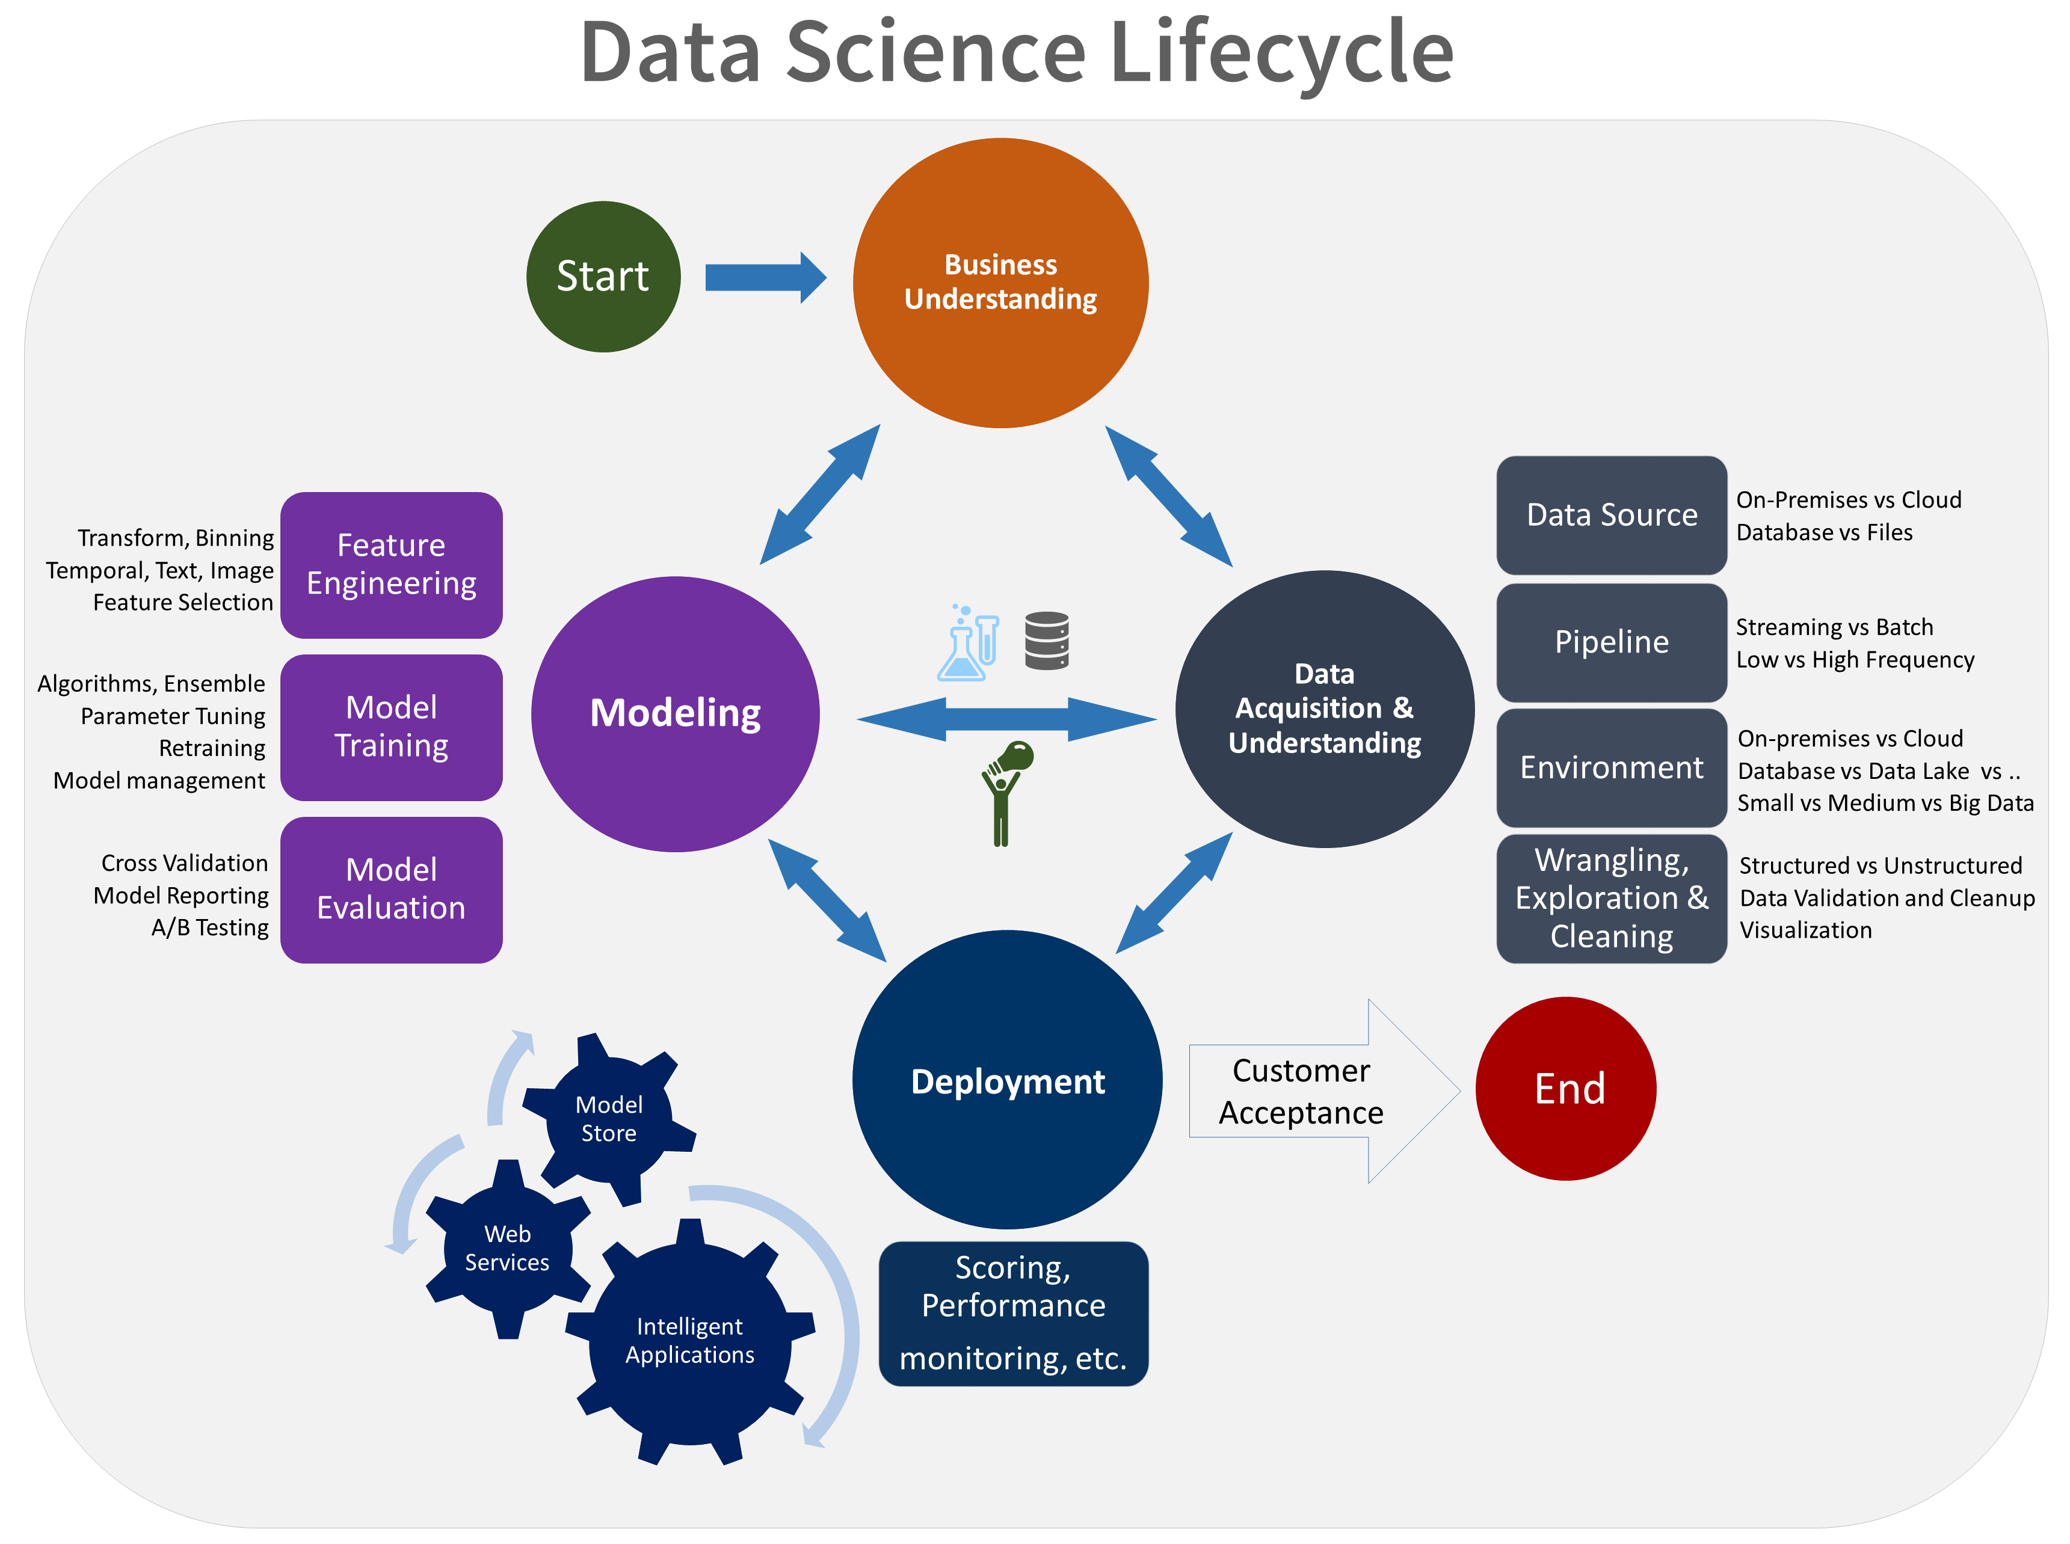
The Data Science Process

Slide 3
Outline
What is Diabetes Mellitus?
Objectives
Data Mining
Feature Exploration
Neural Network
Results
Conclusion/Discussion

Slide 4
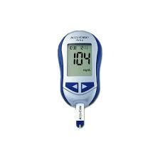
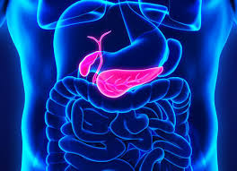
About Diabetes Mellitus
A disease where complications arise in producing and using insulin
100 million plus U.S. adults live with diabetes or prediabetes
There are 3 main classifications:
Type 1
Type 2
Gestational

Slide 5
Goals and Objectives
1. Determine how care management of diabetic patients effects patient outcome.
2. Develop a model that targets diabetic patients and utilizes glucose measurements to predict patient outcome.

Slide 6
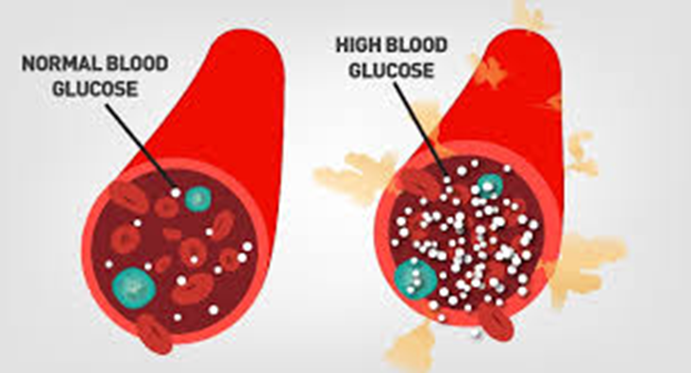
Data Mining and Visualization
Source
Query
Visualize

Slide 7
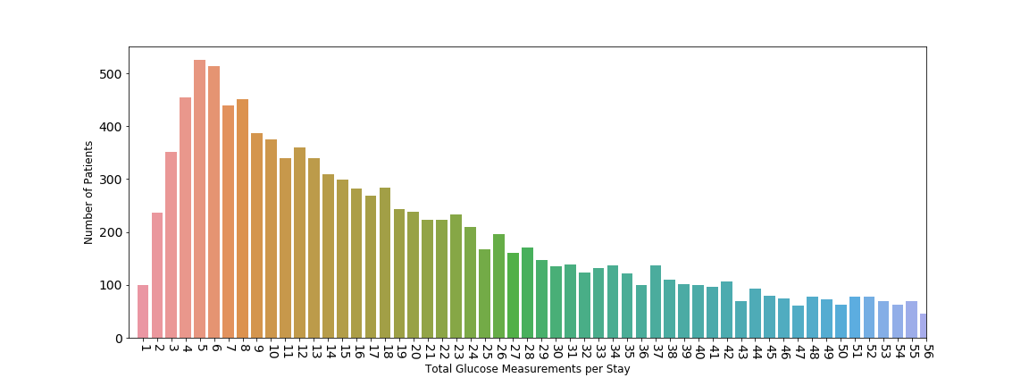
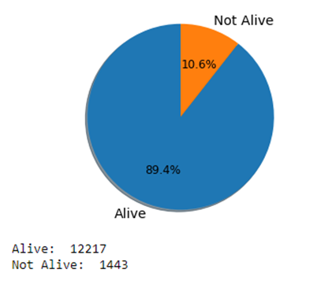
Glucose Measurement Distribution Feature Reduction
Outcome Distribution
Oversampling

Slide 8
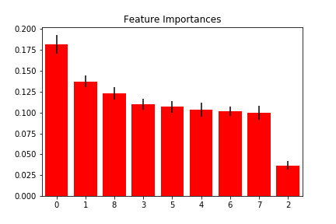
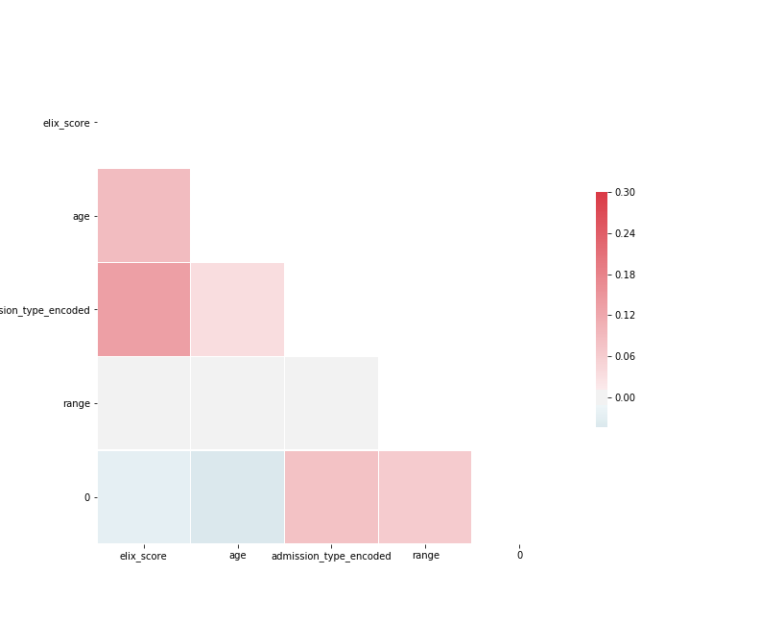
Feature Exploration
0 – Exhauster Score
1 – Age
2 – Admission Type
(3-7) – Glucose Measurements
8 – Glucose Range

Slide 9
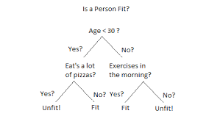
Modeling Techniques
Baseline Models
Decision Tree
Random Forest
Results AUC and Accuracy

Slide 10
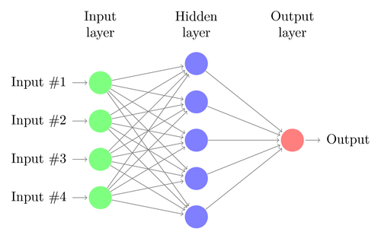
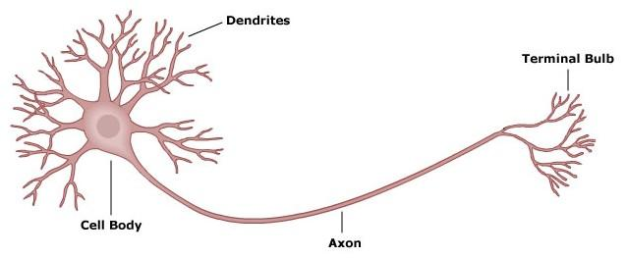
Neural Networks

Slide 11
Results
AUC and Accuracy of Nerual Network include confusion matrix and discuss what was added from this method

Slide 12
Conclusion
Adress the two goals from the beginning

